Slide 1
CCGrid 2009 Report
IEEE/ACM International Symposium on Cluster Computing and the Grid, May 2009, Shanghai, China
Nan Dun
dunnan@yl.is.s.u-tokyo.ac.jp

Slide 2
CCGRid Summary
An Overview of CCGrid Series Conference

Slide 3
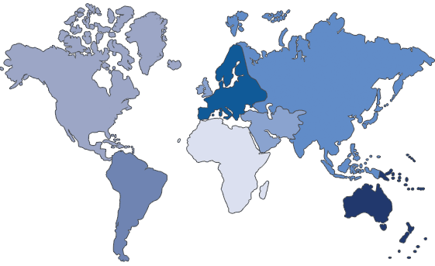
CCGrid Roadmap
CCGrid 2005
Cardiff, UK
CCGrid 2002
Berlin, Germany
CCGrid 2003
Tokyo, Japan
CCGrid 2004
Chicago, USA
CCGrid 2008
Lyon, France
CCGrid 2009
Shanghai, China
CCGrid 2006
Singapore
CCGrid 2001
Brisbane, Australia
CCGrid 2007
Rio, Brazil
CCGrid 2010
Melbourne, Australia

Slide 4
CCGrid Series

Slide 5
Program
Tutorials
  Market-Oriented Grid Computing and the Gridbus Middleware by Rajkumar Buyya
  Distributed Simulation on the Grid by Stephen John Turner and Wentong Cai
  Introduction to Cloud Computing by James Broberg
  Grid Projects in China

Slide 6
Program (cont.)
Keynotes
  Market-Oriented Cloud Computing: Vision, Hype, and Reality of Delivering Computing as the 5th Utility by Rajkumar Buyya
    Slides: http://www.buyya.com/talks/Cloud-Buyya-Keynote2009.pdf
  Challenges and Opportunities on Parallel/Distributed Programming for large-scale:
  from Multi-core to Clouds by Denis Caromel
    URL: http://www.inria.fr/oasis/caromel
  Online Storage and Content Distribution System at a Large Scale: Peer-assistance and Beyond by Bo Li

Slide 7
Program (cont.)
Panel: Cloud Computing: Technical challenges and Business Implications
  Geng Lin, Cisco Systems, USA
  Jinzy Zhu, IBM, China
  Wing-Kin (WK) Leung, Cisco Systems, China
  Rajkumar Buyya, The University of Melbourne, Australia
  Jin Hai, Huazhong University of Science and Technology, China
  Manish Parashar, Rutgers University, USA

Slide 8
Program (cont.)
Sessions: 15
Scheduling in Grid x2 | Data Management
Peer-to-Peer x2 | Performance Modeling
Power Management | Virtualization
Cloud Computing | High-performance communications and Fault Tolerance
I/O & File System | Monitoring and Visualization
Workflow | Matching and Adaptation
Resource Management

Slide 9
CCGrid
CCCloud
?

Slide 10
Cloud Computing
Grid Computing -> Cloud Computing -> Utility Computing?

Slide 11
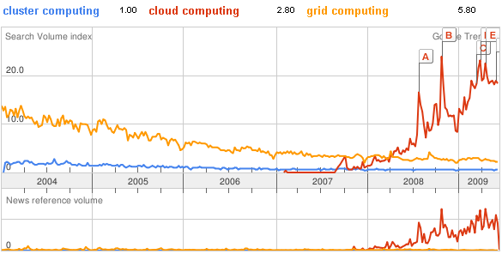
New Trend

Slide 12
What is …
Cloud Computing
  “.. a style of computing in which dynamically scalable and often virtualized resources are provided as a service over the Internet” – wikipedia
  “Clouds are hardware-based services offering compute, network and storage capacity where: Hardware management is highly abstracted from the buyer, Buyers incur infrastructure costs as variable OPEX, and Infrastructure capacity is highly elastic” - McKinsey & Co. Report: “Clearing the Air on Cloud Computing”
  “Cloud computing has the following characteristics: (1) The illusion of infinite computing resources… (2) The elimination of an up-front commitment by Cloud users… (3). The ability to pay for use…as needed…” – UCBerkeley RADLabs
  And over 20 definitions
    http://cloudcomputing.sys-con.com/node/612375/print

Slide 13
What is …
Utility Computing
  “If computers of the kind I have advocated become the computers of the future, then computing may someday be organized as a public utility just as the telephone system is a public utility... The computer utility could become the basis of a new and important industry.”
  —John McCarthy, MIT Centennial in 1961

Slide 14
Enabling Technologies
Virtual Machines
  VMWare
  XenSource
  SWsoft/Parallels
  Microsoft
Virtualized Storage
  Distributed File Systems
    Google File System
    Hadoop Distributed File System (Yahoo! Distribution)
Web Services
  SOAP (Simple Object Access Protocol)
  REST / RESTful (Representational State Transfer)

Slide 15
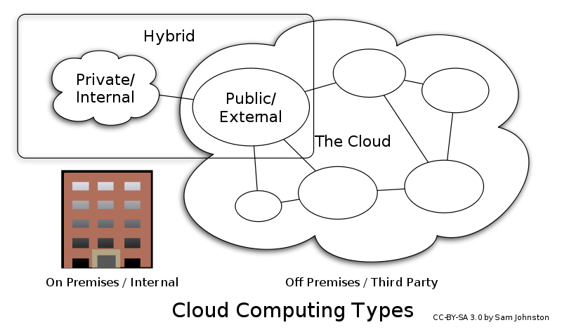
Types of Clouds

Slide 16
Public Clouds
Amazon EC2
  http://aws.amazon.com/ec2/
GoGrid
  http://www.gogrid.com/
Slicehost
  http://www.slicehost.com/
Mosso Cloud Servers
  http://www.mosso.com/

Slide 17
Clouds Comparison
 | Amazon EC2 | GoGrid | Slicehost | Mosso Cloud
Instance Cost | $0.10-$1.28/hr | $0.095-$1.32/hr | $20-$80/month | $0.015-$0.96/hr
Linux | Yes | Yes | Yes | Yes
Windows | Yes | Yes | No | No
Cores/CPU | 1-20 | 1-6 | 4 | 4
Memory | 1.7GB – 15GB | 0.5GB – 8GB | 256MB – 15.5GB | 256MB – 15GB
Storage | No (S3/EBS) | Yes | Yes | Yes
Public IP | No (Elast. IP) | Yes | Yes | Yes
Managed DNS | No | Yes | No | Yes
Support Cost | $400 | Free | Free | $100
Hybrid Cloud | No | Yes | No | Yes
SLA | 99.95% | 100% | N/A | 100%
Running Instances | 20 | ? | ? | Unlimited
API | Yes | Yes | Yes | Yes
Notes:
http://aws.amazon.com/ec2/instance-types/

Slide 18
Public Cloud Storage
Amazon Simple Storage Service
  http://aws.amazon.com/s3/
Amazon CloudFront (CDN)
  http://aws.amazon.com/cloudfront/
Nirvanix Storage Delivery Network
  http://www.nirvanix.com/platform.aspx
Mosso Cloud Files
  http://www.mosso.com/cloudfiles.jsp
Microsoft Azure Storage Services
  http://www.microsoft.com/azure/windowsazure.mspx

Slide 19
Cost Comparison
 | Nirvanix Global SDN < 2TB | Amazon S3 USA < 10TB | Amazon S3 Europe < 10TB | Amazon CloudFront < 10 TB | Mosso CloudFiles < 5TB
Incoming ($/GB) | 0.18 | 0.1 | 0.1 | N/A | 0.08
Outgoing ($/GB) | 0.18 | 0.17 | 0.17 | 0.17 – 0.21 | 0.22
Storage ($/GB/Mon) | 0.25 | 0.15 | 0.18 | N/A | 0.15
Requests ($/1000 PUT) | 0.00 | 0.01 | 0.012 | N/A | 0.02
Requests ($/1000 GET) | 0.00 | 0.01 | 0.012 | 0.010 – 0.013 | 0.00

Slide 20
Feature Comparison
 | Nirvanix Global SDN | Amazon S3 | Amazon CloudFront | Mosso CloudFiles
SLA | 99.9 | 99 – 99.9 | 99 – 99.9 | 99.9
Max File Size | 256GB | 5GB | 5GB | 5GB
US Ava. | Yes | Yes | Yes | Yes
EU Ava. | Yes | Yes | Yes | Yes
Asia Ava. | Yes | No | Yes | Yes
Per file ACL | Yes | Yes | Yes | Yes
Auto Replication | Yes | No | Yes | Yes
API/Web services | Yes | Yes | Yes | Yes

Slide 21
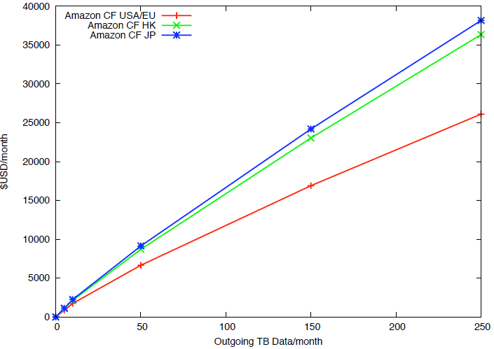
Pricing Comparison

Slide 22
A little more about CDNs
Content Delivery Networks
  Akamai: 80% market share
    Expensive, 2-15 times than cloud storage
    1-2 year commitments and min. 10TB data
  Academic CDN: Coral, Codeen, Globule
    No SLA, best effort only

Slide 23
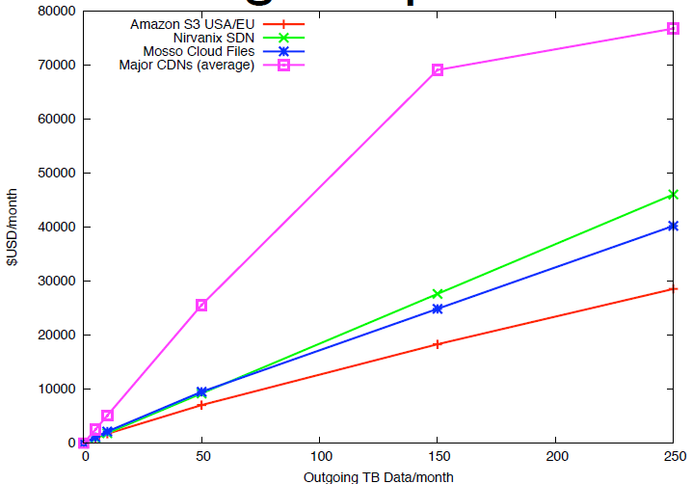
Pricing Comparison

Slide 24
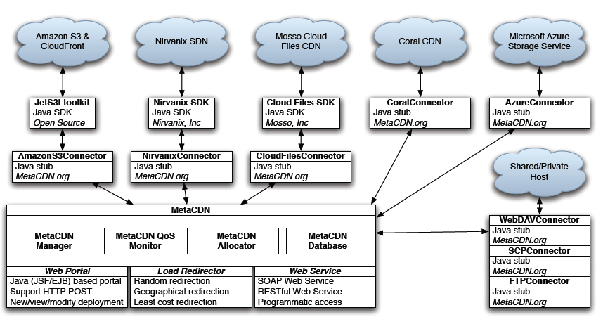
MetaCDN^{http://www.metacdn.org}

Slide 25

Case Study: Smugmug

Slide 26

Case Study: Animoto

Slide 27
Technical Sessions
Monitoring and Visualization

Slide 28
Session: Monitoring and Visualization
Towards Visualization Scalability through Time Intervals and Hierarchical Organization of Monitoring Data
Lucas Mello Schnorr†‡, Guillaume Huard‡, Philippe Olivier Alexandre Navaux†
†Instituto de Inform´atica Federal University of Rio Grande do Sul
‡INRIA Moais research team CNRS LIG Laboratory - Grenoble University

Slide 29
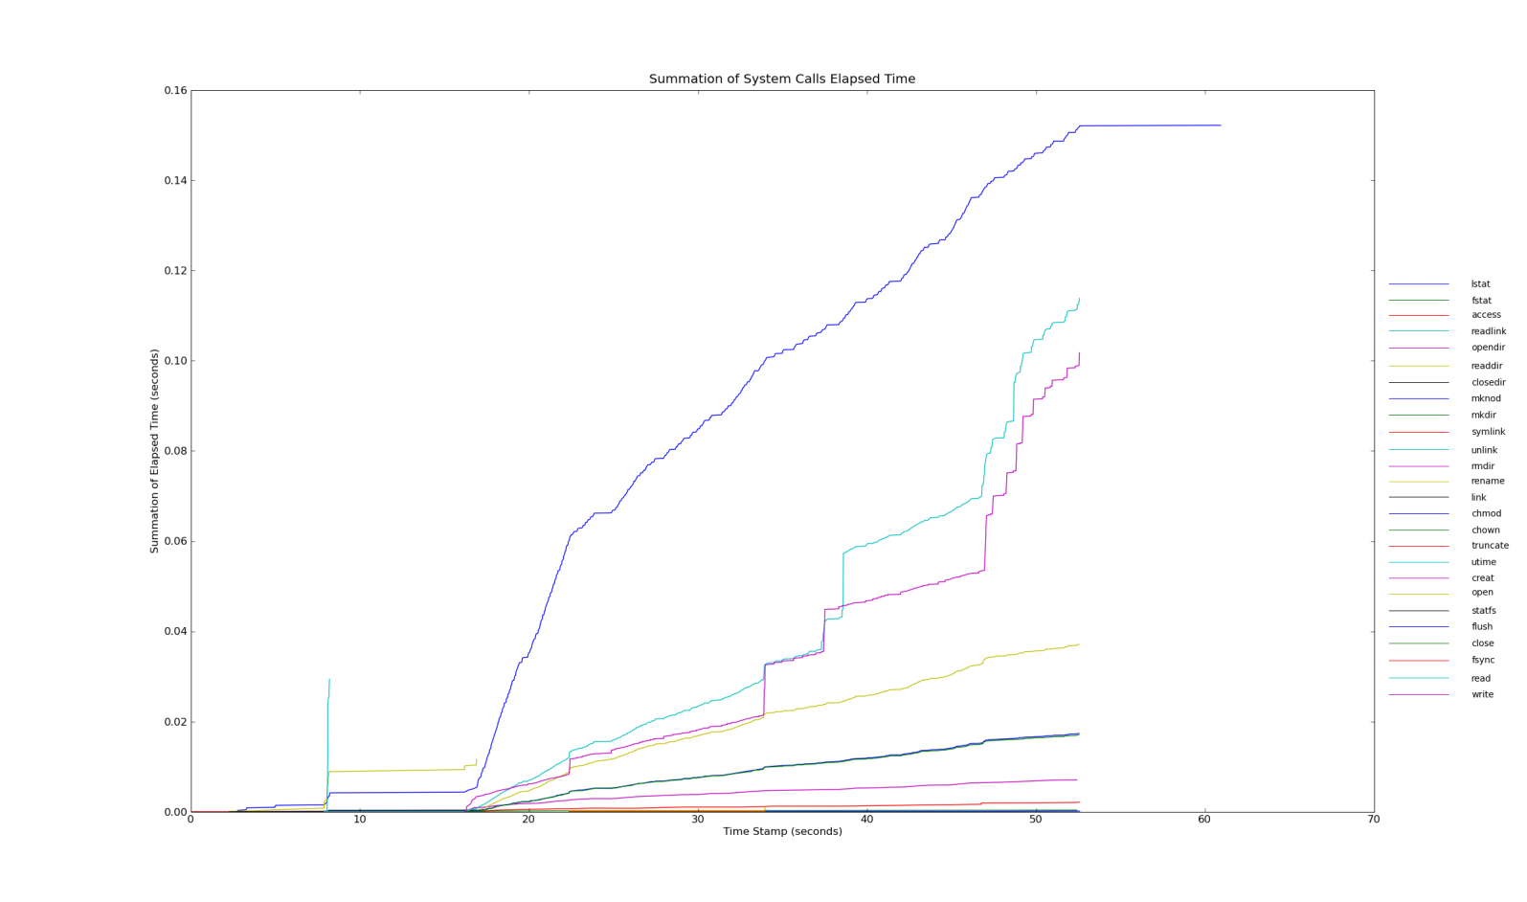
Motivation
Scalable Visualization of Large-Scale Tracing Data
What if we have thousands of process, threads to summarize and compare?
ParaTrac v 0.2 Tracing Plot
List of Process, threads
System Statistic Value
Time line

Slide 30
We want to find out by visualization
Monitoring more variables at the same time
Comparison among behaviors
Visualized application pattern
Application evolution along with time
  Within arbitrary time interval
  Scroll from start to end

Slide 31
Scalable Hierarchical Visualization
Hierarchical Monitoring Data
Grid
Grid
Cluster
CA
CB
Cn
Machine
MA₁
MA_{n}
MB₁
MB_{n}
MC₁
MC_{n}
Process
CPU
P₁
P₇
P₁₂
P_{n}
Thread
Tracing Level
Entity Types
Instances

Slide 32
Enabling Techniques
Treemaps [Bruls et al. 2000]
A
E
H
B
C
D
F
I
G
D
E
F
G
H
I

Slide 33
Time-Slice Algorithm
time
T_{i}=5.0
T_{f}=10.0
M1
A
AT_{i}=4.5
AT_{f}=10.5
BTi=4.0
BT_{f}=6.0
B
M2
C
CTi=7.5
CT_{f}=10.4
D
DTi=6.5
DT_{f}=7.7
Et_{f}=12
E
ETi=10.3

Slide 34
Define Values in Time Slice
Based on the amount of time
Based on the discrete events

Slide 35
Examples: Amount of Time
Data
Treemaps
R=1.94
A=1
C=0.6
M1=1.2
M2=0.74
B=0.2
C=0.24
A=1
B=0.2
C=0.5
D=0.24
E=0

Slide 36
Examples: Singular Events
Data
Treemaps
R=7
B=3
C=2
D=1
M1=3
M2=4
E=1
A=0
B=3
C=2
D=1
E=1

Slide 37
Experiments
Exp. 1
  200 processes on 200 machines
  5 clusters: A, B, C, D, E
  KAAAPI library for job balancing: stealing
Exp. 2
  2900 processes on 310 machines
  7 clusters

Slide 38
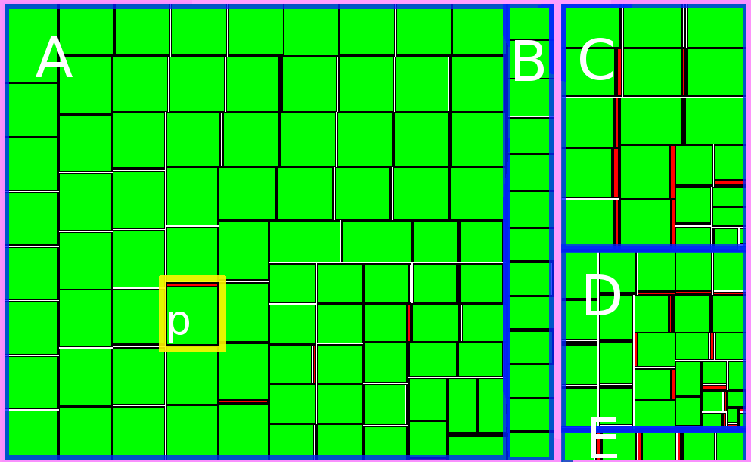
Start of Execution

Slide 39
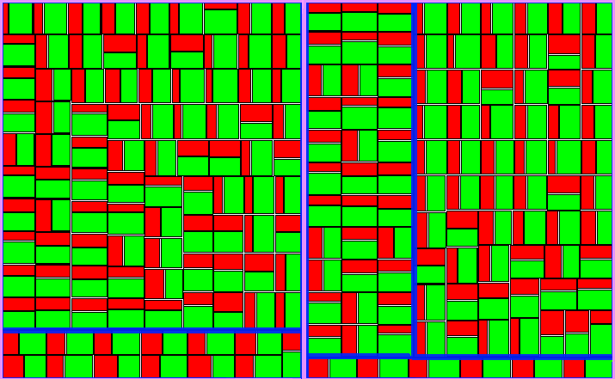
End of Execution

Slide 40
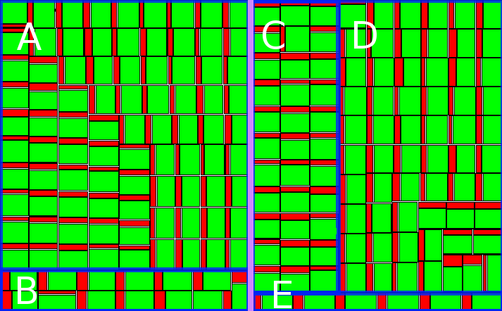
Total Time of Execution

Slide 41
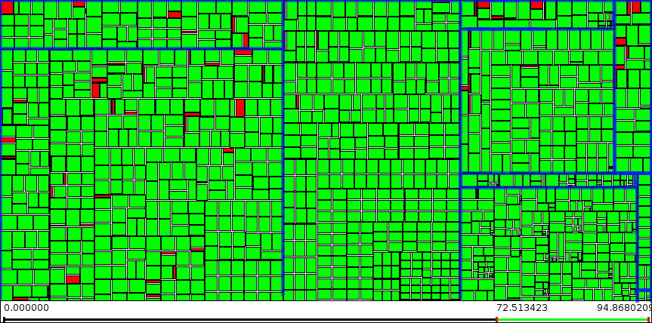
Large-Scale
Process: 14.5 times, screen space: 1.2 time

Slide 42
CRYSTAL CG Co. LTD
The Olympic CG Provider (not only Beijing 2008, but also London 2012)
http://www.crystalcg.com/

Slide 43

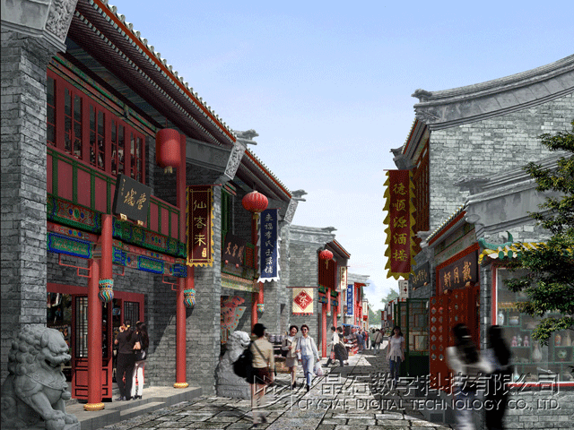
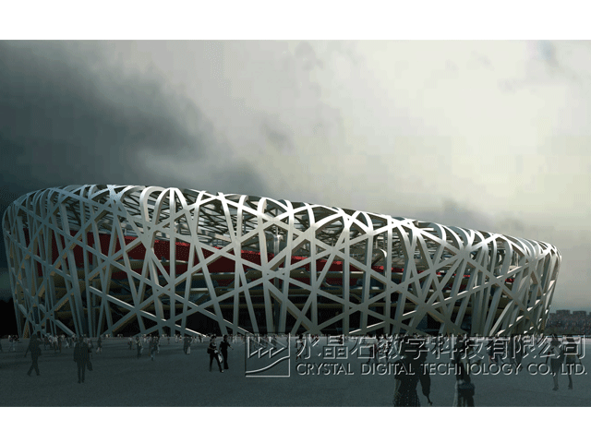

Slide 44
History
Founded in 1995 at Beijing
  No one knew it before 2008
Now
  Beijing 2008 Olympic, London 2012 Olympic, Shanghai 2010 EXPO, etc. contracts
  Well know in China, even in the World

Slide 45
Not a Big Company
People
  A groups of young leaders
  Many trained, skilled workers
    equivalent to junior college, 専門学校
Environments and Machines
  Warehouse-like work places, not office
  Hundreds of fully DIY commodity PCs
    like Akiba-assembled
Business
  World-class business
  Local commercial, CG education

Slide 46
Their Problems
Scalability!
  Contracts means works and deadlines
    3ds Max parallel rendering queue is jammed
    Simply add more machines does not work
  Looking for a Cloud solution
    QoS
    Deploy effort: licenses, new APIs, bandwidths
    Data security

Slide 47
Questions?
Please feel free to ask if you want a copy of CCGrid 2009 e-proceedings

